Slide 1
Finite-difference methods for boundary-value problems

Slide 2
Introduction
In this topic, we will
Describe finite-difference approximations of linear ordinary differential equations (lodes)
See how this can be used to approximate solutions to boundary-value problems (bvps)
Observe that this defines a system of linear equations
Look at examples with both constant coefficients and with variable coefficients
Describe implementations in Matlab

Slide 3
Linear ordinary differential equations
In this lecture, we will focus on a technique appropriate for linear ordinary differential equations (lodes)
The most general form is a linear combination of u(x) and its derivatives:
The coefficients can be functions of x
In your calculus course, you focused on solutions to lodes with constant coefficients:
These approximation techniques will, however, generalize

Slide 4
Approximating the derivative
Previously, we saw two approximations:
How about substituting these two approximations into the lode?

Slide 5
Thus, we go from
to

Slide 6
Let’s expand this and collect on u(x – h), u(x) and u(x + h):

Slide 7
Finally, multiply by 2h²:

Slide 8
Therefore, if u(x) satisfies this lode,
then it must also be true that

Slide 9
Visualization
Let’s look at the problem visually:
Break the interval [a, b] into n sub-intervals
Each is of width
Thus, x_{k} = a + kh with x₀ = a and x_{n} = b
a
x₁
x₂
x₃
x₄
x₅
x₆
x₇
x₈
x₉
b

Slide 10
Visualization
Let’s focus on a single point x_{k}:
We don’t know the value of u(x_{k}), but the following equation should hold approximately true:
Represent our estimate of u(x_{k}) with u_{k} so u_{k} ≈ u(x_{k})
x₀
x₁
x₂
x_{k–1}
x_{k}
x_{k+1}
x_{n–2}
x_{n–1}
x_{n}

Slide 11
Visualization
Note that x_{k} – h = x_{k–1} and x_{k} + h = x_{k+1},
u(x_{k} – h) = u(x_{k–1}) ≈ u_{k–1}
u(x_{k} + h) = u(x_{k+1}) ≈ u_{k+1}
x₀
x₁
x₂
x_{k–1}
x_{k}
x_{k+1}
x_{n–2}
x_{n–1}
x_{n}

Slide 12
Visualization
This looks ugly, but all four functions a₂, a₁, a₀ and g as well as h are all known
Therefore, this is a linear equation in three unknowns
x₀
x₁
x₂
x_{k–1}
x_{k}
x_{k+1}
x_{n–2}
x_{n–1}
x_{n}

Slide 13
Visualization
There are unknowns from k = 1, 2, …, n – 1
This gives n – 1 equations in the n + 1 unknowns u₀, u₁, …, u_{n–1}, u_{n}

Slide 14
Visualization
Fortunately, we have two boundary values, so:
u₀ = u_{a}
u_{n} = u_{b}
Thus, Equations for k = 1 and k = n – 1 may be slightly modified:

Slide 15
Thus, we have a system of n – 1 linear equations in n – 1 unknowns
This is a tri-diagonal matrix
It can be solved in O(n) time, and not O(n³) time

Slide 16
Suppose we have a lode with constant coefficients:
Now the matrix entries are identical:

Slide 17
Our matrix is now greatly simplified:
All entries on the diagonal, the super-diagonal and the sub-diagonal are the same

Slide 18
Examples
We will first look at both an implementation of, and an example of a bvp with constant coefficients
That is, a₂, a₁ and a₀ fixed real values
Next, we will look at the implementation of, and an example of a bvp with non-constant coefficients
That is, a₂, a₁ and a₀ are functions of x

Slide 19
Constant coefficient example
function [xs, us] = bvpcc( ode, g, x_rng, u_bndry, n )
h = (x_rng(2) - x_rng(1))/n;
p = 2.0*ode(1) - ode(2)*h;
q = -4.0*ode(1) + 2.0*ode(3)*h^2;
r = 2.0*ode(1) + ode(2)*h;
A = diag( q*ones( n - 1, 1 ) ) ...
+ diag( r*ones( n - 2, 1 ), 1 ) ...
+ diag( p*ones( n - 2, 1 ), -1 );
xs = linspace( x_rng(1) + h, x_rng(2) - h, n - 1 )';
v = 2.0*g( xs )*h^2;
v(1) = v(1) - p*u_bndry(1);
v(end) = v(end) - r*u_bndry(2);
us = A \ v;
xs = [x_rng(1); xs; x_rng(2)];
us = [u_bndry(1); us; u_bndry(2)];
end

Slide 20
Constant coefficient example
Suppose we have the following bvp:
If n = 10, then h = 0.2, so
Also, the x-values are –1, –0.8, –0.6, –0.4, –0.2, 0, 0.2, 0.4, 0.6, 0.8, 1

Slide 21
Constant coefficient example
Thus, we have our system of linear equations

Slide 22
Constant coefficient example
Solving this system of linear equations yields:

Slide 23
Constant coefficient example
In Matlab, we can find this by calling:
>> [xs, us] = bvpcc( [1 3 2], @sin, [-1 1], [1 2], 10 );
>> u = @(x)( -0.32523483298690115734*exp( 2.0 - 2.0*x) ...
- 0.19505820123410984121*exp(-1.0*x - 1.0) ...
+ 0.32523483298690115734*exp(-1.0*x + 3.0) ...
+ 0.19505820123410984121*exp(-2.0*x) ...
- 0.3*cos(x) + 0.1*sin(x);

Slide 24
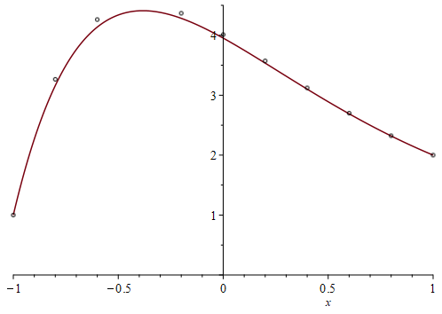
Constant coefficient example
Here is a plot of the solution and the approximations:

Slide 25
General example
function [xs, us] = bvp( a2, a1, a0, g, x_rng, u_bndry, n )
h = (x_rng(2) - x_rng(1))/n;
p = @(x)( 2.0*a2(x) - a1(x)*h );
q = @(x)(-4.0*a2(x) + 2.0*a0(x)*h^2);
r = @(x)( 2.0*a2(x) + a1(x)*h );
xs = linspace( x_rng(1) + h, x_rng(2) - h, n - 1 )';
A = zeros( n - 1, n - 1 );
for k = 1:(n - 1)
A(k, k) = q(xs(k));
end
for k = 1:(n - 2)
A(k + 1, k ) = p(xs(k + 1));
A(k, k + 1) = r(xs(k));
end

Slide 26
General example
v = 2.0*g( xs )*h^2;
v(1) = v(1) - p(xs(1) )*u_bndry(1);
v(end) = v(end) - r(xs(end))*u_bndry(2);
us = A \ v;
xs = [x_rng(1); xs; x_rng(2)];
us = [u_bndry(1); us; u_bndry(2)];
end

Slide 27
General example
Suppose we have the following bvp:
If n = 10, then h = 0.2, so
As before, the x-values are –1, –0.8, –0.6, –0.4, –0.2, 0, 0.2, 0.4, 0.6, 0.8, 1

Slide 28
General example
Thus, we have our system of linear equations

Slide 29
General example
Solving this system of linear equations yields:

Slide 30
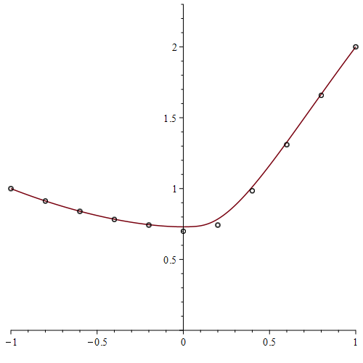
General example
Here is a plot of the solution and the approximations:
In this case, there is no exact solution, so the solution is actually a very precise numerical approximation

Slide 31
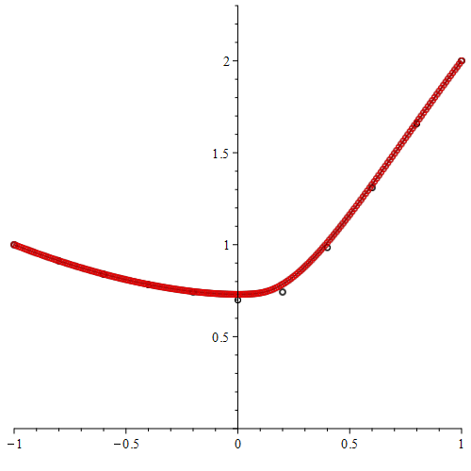
General example
We can also use more points:
>> [xs, us] = bvp( @(x)(x^2*13), @(x)(-5.0), @(x)(8*x),...
@sin, [-1 1], [1 2], 200 )

Slide 32
Error analysis
Beyond the scope of this course, even though we are using two O(h²) approximations of the derivative and second derivative
The overall error of this method is still O(h²) as we are solving these simultaneously
Thus, doubling the number of intervals reduces the error by four

Slide 33
Summary
Following this topic, you now
Understand the idea finite difference approximations
For a lode, we substitute approximations of the derivative and second derivatives
Know that this defines a system of linear equations
Understand that this solution gives the approximations at the equally spaced points between a and b
Are aware that if the lode has constant coefficients, all entries on the diagonal, super-diagonal and sub-diagonal are equal, respectively
Have seen implementations in Matlab

Slide 34
References
[1] https://en.wikipedia.org/wiki/Finite_difference_method

Slide 35
Acknowledgments
None so far.

Slide 36
Colophon
These slides were prepared using the Cambria typeface. Mathematical equations use Times New Roman, and source code is presented using Consolas. Mathematical equations are prepared in MathType by Design Science, Inc.
Examples may be formulated and checked using Maple by Maplesoft, Inc.
The photographs of flowers and a monarch butter appearing on the title slide and accenting the top of each other slide were taken at the Royal Botanical Gardens in October of 2017 by Douglas Wilhelm Harder. Please see
https://www.rbg.ca/
for more information.

Slide 37
Disclaimer
These slides are provided for the ece 204 Numerical methods course taught at the University of Waterloo. The material in it reflects the author’s best judgment in light of the information available to them at the time of preparation. Any reliance on these course slides by any party for any other purpose are the responsibility of such parties. The authors accept no responsibility for damages, if any, suffered by any party as a result of decisions made or actions based on these course slides for any other purpose than that for which it was intended.

